Slide 1
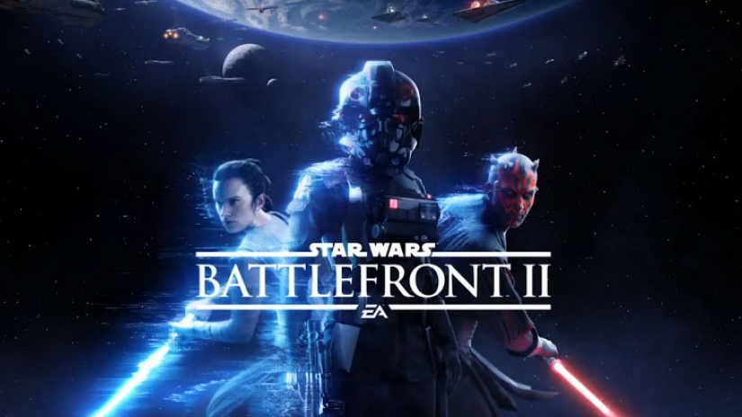
Star Wars Battle Front 2 The Good, The Bad, The Dark Side
By: Shunmas Cummings, Robin Henderson
Capstone Project MIS 670

Slide 2
Business Questions
Main Question: Has Star Wars Battle Front 2 lived up to its high expectations and all of the media hype before and after its release?
Were the tweets that were gathered mostly positive or mostly negative on both sets of data collection?
What were the most popular words/hashtags used with positive tweets and negative tweets?
With the data that is collected, what will be the overall review for the game for the weeks to come?
Looking at the data, what kind of effect will Star Wars Battle Front 2 have on Electronic Arts?

Slide 3
Data Collection
We collected two sets of data by the use of Twitter API
First set of data was collected for 5 days prior to release, which was November 17th
Second set of data was collected for 5 days after release
These were the hashtags that we used to collect data from Twitter
battlefront2, eastarwars, battlefrontii, bf2, battlefrontii, bf2, bfii, starwarsbattlefront2, starwarsbattlefrontii, swbf2, swbfii, bravointel, ea_dice, thestarwarshq, swbfupdates

Slide 4
Data Information
Data Set One
143,818 Total Tweets Collected
90,106 Screen Names
42% Original Tweets
78,997 English Tweets
31,109 Original English Tweets
Data Set Two
143,363 Total Tweets Collected
81,974 Screen names
50% Original Tweets
94,759 English Tweets
34,335 Original English Tweets

Slide 5
Sentiment Analysis
For sentiment analysis, we went ahead and used Pattern (Python Package) and Bing-Liu Lexicons on both data sets
We did this to see if there was any significant differences between the two
Did the sentiment analysis on Original English Tweets

Slide 6
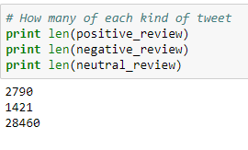
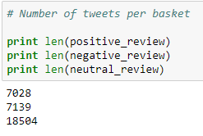
Difference between the two Sentiment Packages
Pattern Python Package
Bing-Liu Lexicons
Generalized Words
Left more Tweets in the “Neutral” category
Specific Words
Categorized more of the Tweets into “Positive” and “Negative”

Slide 7
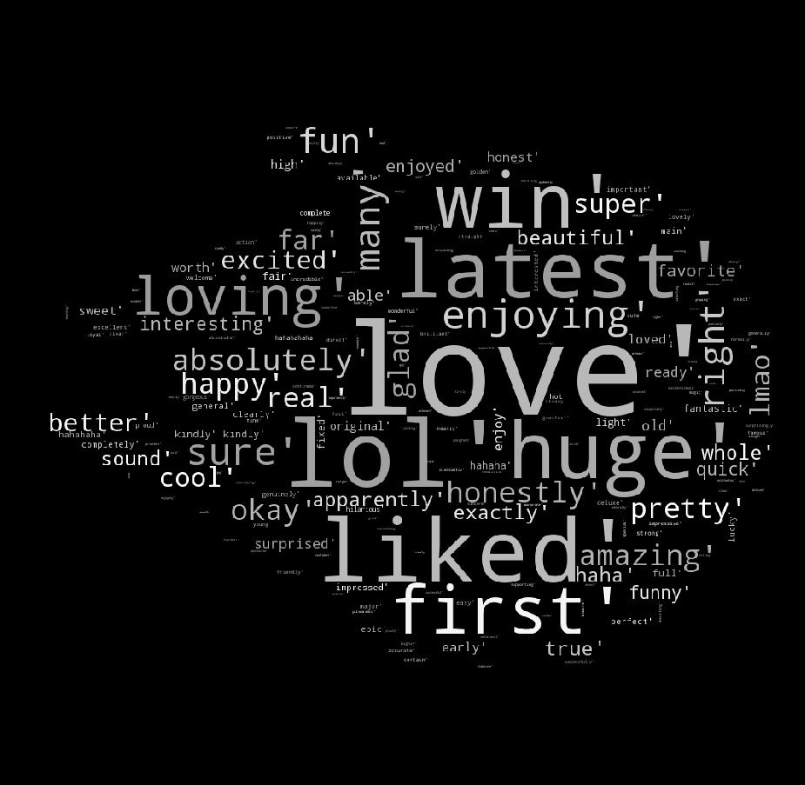
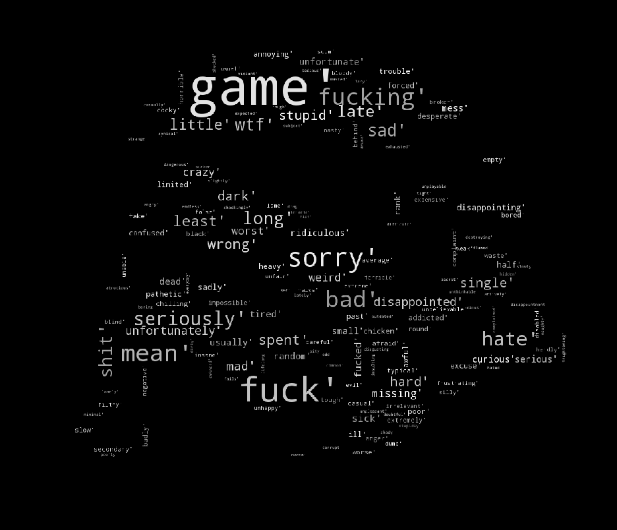
Pattern Python Package Word Clouds
Positive Sentiment
Negative Sentiment

Slide 8
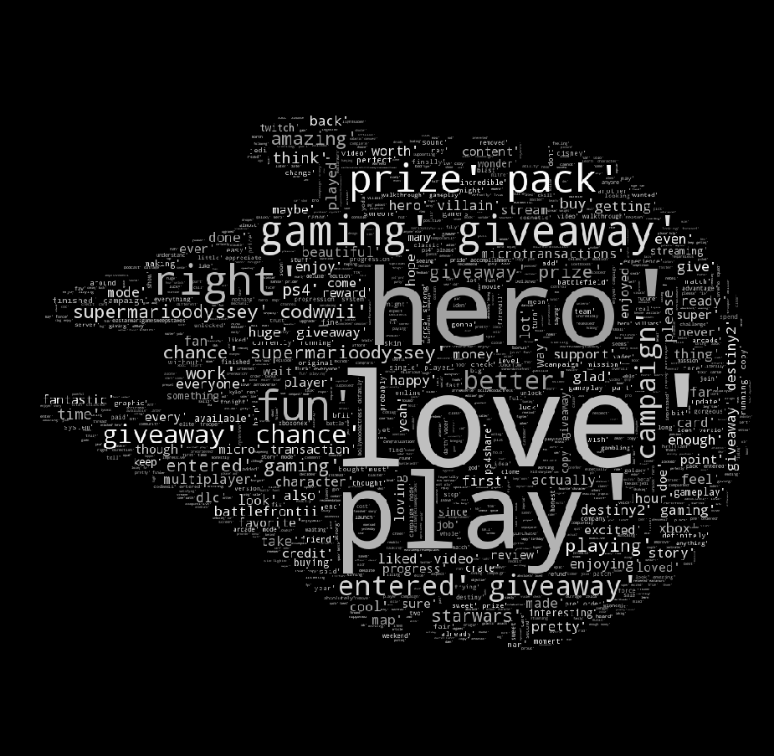
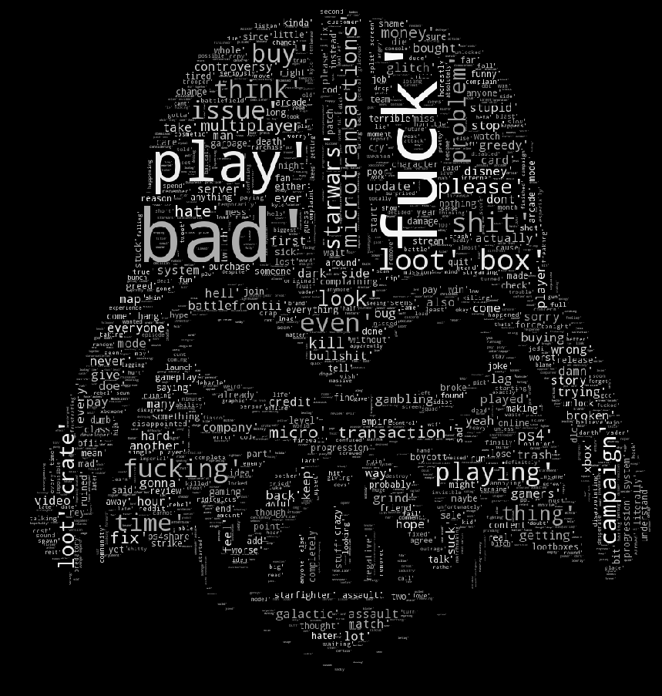
Bing-Liu Lexicon Word Clouds
Positive Sentiment
Negative Sentiment

Slide 9
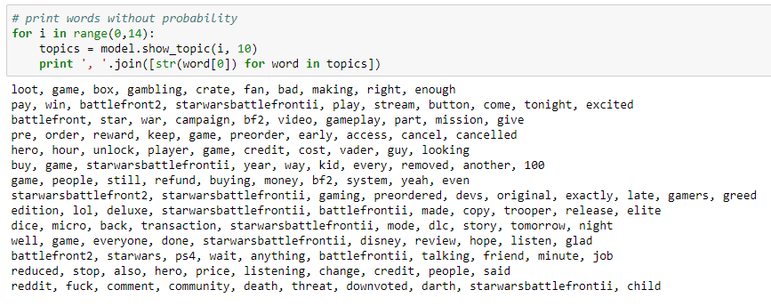
Topic Modeling
Below is a picture of the topics that were generated from the LDA Model with 15 topics and 20 passes

Slide 10
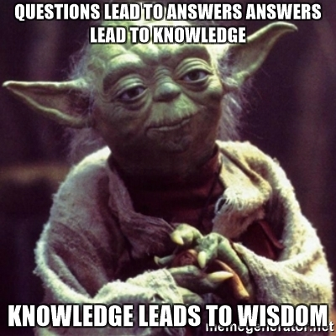
Questions?

